Slide 1
LINKERS & LOADERS
Presented By Adsure Sharad S

Slide 2
SYLLABUS – UNIT III
Introduction, Loader schemes: Compile and Go, General Loader Scheme, Absolute Loaders, Subroutine Linkages, Relocating Loaders, Direct linking Loaders, Overlay structure, Design of an Absolute Loader, Design of Direct linking Loader, Self-relocating programs, Static and
Dynamic linking. (07 Hrs)
#Exemplar/Case Studies: Study the concepts of Class loading in Java.
*Mapping of Course : Outcomes for Unit III : CO1, CO2, CO3
CO1:Analyze and synthesize basic System Software and its functionality.
CO2: Identify suitable data structures and Design & Implement various System Software
CO3: Compare different loading schemes and analyze the performance of linker and loader
2

Slide 3
PRESENTATION OUTLINE
Introduction
Loader schemes:
Compile and Go, General Loader Scheme, Absolute Loaders, Subroutine Linkages, Relocating Loaders, Direct linking Loaders, Overlay structure
Design of an Absolute Loader
Design of Direct linking Loader,
Self-relocating programs,
Linkers
Static and Dynamic linking.
Case Study
Lab Assignment on DLL
3

Slide 4
BASICS…..
C program: ABC.c
Compiler
Object(mach lang module): ABC.o
Linker
lib.o
Executable(mach lang pgm): a.out
Loader Memory
4

Slide 5
LOADERS : INTRODUCTION
The source program is converted to object program by assembler.The loader is a program which takes this object program, prepares it for execution, and loads this executable code of the source into memory for execution.
Definition of Loader:
Loader is system program which takes object code as input prepares it for execution and loads the executable code into the memory.
6
06/08/2021

Slide 6
LOADERS
Source Program
Assembler
Object Program
Places the object code in Main Memory and Initiates the Execution
Loader
6

Slide 7
FUNCTIONS OF A LOADER
Allocation
Allocate space in memory for the program
Linking
Resolve symbolic references between object decks
Relocation
Adjust all address dependent locations such as address constants, to correspond to the allocated space
Loading
Physically place the machine instruction & data into the memory
7

Slide 8
LOADER SCHEMES
Based on the functionalities of loader, there are various types of loaders.
Compile and Go Loader Scheme, General Loading Scheme and many more….
8

Slide 9
COMPILE AND GO LOADERS
Program loaded in memory
Assembler
Compile-and-go translator
Source Program deck

Slide 10
COMPILE AND GO LOADER SCHEME
In this scheme the assembler runs in one part of the memory.
The assembler places the assembled machine instructions and data as they are assembled directly into their assigned memory locations.
When the assembly is complete the assembler causes a transfer to the starting
instruction of the program.
This scheme was used by WATFOR FORTRAN Compiler.
In this scheme the assembler simply places the code into the core & the loader consists of one instruction that transfers to the starting address of newly assembled program.

Slide 11
COMPILE AND GO LOADER SCHEME
Advantages
This scheme is simple to implement. Because assembler is placed at one part of the memory and loader simply loads assembled machine instructions into the memory.
Disadvantages
The portion of memory is wasted because the core occupied by assembler is unavailable to the object Program.
It is necessary to retranslate the user program decks, every time it is run.
It is very difficult to handle multiple segments, specially if the source program are in different languages.
It is difficult to produce orderly modular program.
The execution time will be more in this scheme as every time program is assembled and then executed.

Slide 12
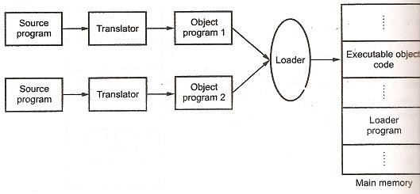
GENERAL LOADER SCHEME

Slide 13
GENERAL LOADER SCHEME
In this scheme the assembled program is loaded into the core, which eventually frees up the
space allocated to assembler in the previous scheme.
This scheme requires a LOADER, which accepts the assemble machine instructions, data & other information present in the object format and place machine instruction & data in core in an executable format.
The loader occupies some portion of main memory.
No reassembly requires to run the program at later date.
Possible to write different subroutines in different languages.

Slide 14
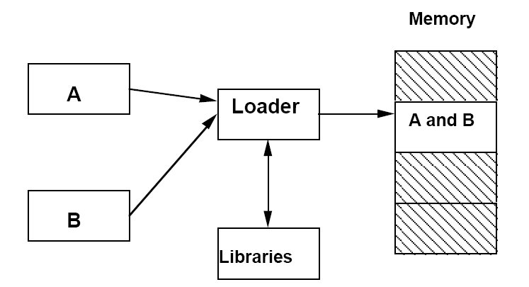
GENERAL LOADER SCHEME

Slide 15
ADVANTAGES
The program need not be retranslated each time while running it. .obj file can be used if required.
There is no wastage of memory, because assembler is not placed in the memory, instead of it, loader occupies some portion of the memory.And size of loader is smaller than assembler, so more memory is available to the user.
It is possible to write source program with multiple programs and multiple languages, because the source programs are first converted to object programs always, and loader accepts these object modules to convert it to executable form.

Slide 16
 | Compile and Go | General Loader Scheme
 | A portion of memory is wasted because the memory occupied by the assembler is unavailable to the object program. | More memory available to the User as loader is small as compared to assembler/compiler.
 | It is necessary to re-translate (assemble) the user's program file every time it is running. | Reassembly not required to run program at later date..
 | It is very difficult to handle multiple segments, especially if the source programs are in different. | If translators produce compatible object deck formats and use compatible conventions, its possible to write subroutines in different languages
 | The execution time will be more in this scheme as every time program is assembled and then executed. | The execution time is less in this scheme.

Slide 17
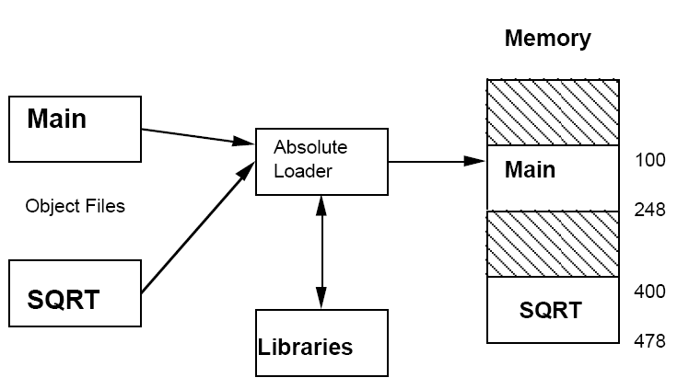
ABSOLUTE LOADER
Simplest Scheme belonging to General
loader Scheme
Loader loads the object program into core specified by the translator itself
Absolute Loading
Allocation- done by Programmer
Linking-done by Programmer
Relocation-done by translator
Loading –done by loader

Slide 18
ABSOLUTE LOADER
Advantages:
Simple to implement
More core is available for loading
Disadvantages:
Programmer has to specify locations in the core where program will be loaded by
loader
Multiple subroutines/segments programmer has to remember the absolute address of each segment and use it explicitly during programming
Increase in one program segment may cause overlapping with another program

Slide 19
SUBROUTINE LINKAGES
Problem of Subroutine Linkages:
A main program A wishes to transfer to subprogram B. The programmer in program A could write a transfer instruction to subprogram B.
Assembler does not know the value of symbol reference and will declare it as an error unless a special mechanism has been provided.
To realize such interactions A and B must contain public definition and external references
ENTRY statement
It lists those symbols defined in the program unit which may be referenced in other program units.
EXTRN statement
Lists the symbols to which external references are made.

Slide 20
MAIN
START
EXTRN SUBROUT1
........
........
L 15,=A(SUBROUT1) BALR 14,15
....... END
SUBROUT1
START
USING *,15
........
........ BR 14
END
Subroutine SUBROUT1
Main program calling to subroutine SUBROUT1

Slide 21
RELOCATING LOADER
The main drawback of Absolute loader is the need of reassembly of all subroutines even if one subroutine is changed.
This drawback is removed in Relocating loader.
BSS(Binary Symbolic Subroutine) Loader. (IBM 7094, IBM 1130,GE 635, UNIVAC 1108)
BSS Loader allows many program segment but only one data segment.
BSS Loader assumes that assembler will provide:
Transfer vector
Relocation bits
Machine code for source program
Length of the program
Length of the Transfer vector

Slide 22
RELOCATING LOADERS
The assembler assembles each procedure segment independently and pass on to the loader text & information as to relocation & intersegment reference.
There are two methods for specifying relocation as part of the object program.
Transfer Vector
Relocation Bits
Many code segment and one data segment

Slide 23
a) Modification Record : In this, for each source program the assembler outputs the text prefix by a transfer vector that consists of address containing names of the subroutines referenced by the source program.The length of entire program and length of transfer vector portion is provided by the assembler to the loader.
Call to subroutine
Transfer vector location to subroutine
Actual core location of Sub routine
b) Relocation Bit:The assembler associates a bit with each instruction or address field. If this bit field equals 1 then corresponding address field must be relocated, otherwise the field is not relocated.

Slide 24
Source Program
Program Length =48 Bytes
Transfer Vector=8 Bytes
Rel. Relocation Object Code
START EXTERN SQRT EXTERN ERR
MAIN
Add.
0 | 00 | ‘SQRT’
4 | 00 | ‘ERRb’
8 | 01 | ST |  | 14,36
12 | 01 | L |  | 1,40
16 01 BALR 14,0
20 24 | 01 01 | C BC |  | 1,44 7,4
28 | 01 | L |  | 14,36
32 | 0 | BCR 15,14
34 | 0 |  | (Skipped for alignment)
36 | 00 |  | (Temp. Location)
40 | 00 | 9
44 | 00 | F’3’
ST 14,SAVE
 | L BALR | 1,=F’9’ 14,SQRT
 | C | 1,=F’3’
 | BNE | ERR
 | L | 14,SAVE
 | BR | 14
SAVE | DS END | F

Slide 25


Absolute
Address
Relative
Address
BSS LOADING OF PROGRAMS FOR DIRECT ACCESS 360
.
.
BC BC ST L
BALR C
BC L BCR
15,448
15,526
14,436
1,440
14,400
1,444
7,404
4,436
15,14
.
.
400
0
404
4
408
8
412
12
416
16
420
20
424
24
428
28
432
32
436
36
440
40
444
44
.
(Temp Loc) left for alignment purpose
9
3
.
.
.
.
.
448
.
SQRT
.
526
ERR
.
26
.
06/08/2021

Slide 26
ADVANTAGES AND DISADVANTAGES
The transfer vector linkages is only useful for transfers & is not suited for loading or storing external data.
Transfer vector increases the size of object program in memory.
BSS loader processes procedure segments but does not facilitate access to data segments that can be shared called COMMON
All 4 functions done by the loader
Relocation bits are used to solve the problem of relocation.
Transfer vector is used to solve the problem of
linking.
Program length information is used to solve the problem of allocation.

Slide 27
DIRECT LINKING LOADERS
It is a general relocatable loader and the most popular loading scheme.
It has the advantage of allowing the programmer multiple procedure segment and multiple data segments giving the programmer a complete freedom in referencing data or instructions contained in other segments

Slide 28
DIRECT LINKING LOADERS
The assembler provides
The length of segment
A list of all entries and their relative location within the segment
A list of all external symbols
Information as to where address constants are loaded in the segment and a description of how to revise their values.
The machine code translation of the source program and the relative addresses assigned

Slide 29
ASSEMBLER RECORDS
External Symbol Dictionary (ESD) record: Entries and Externals
The text (TXT) records contains the actual object code translated version of the source program.
The Relocation and Linkage Directory (RLD) records contains relocation information
The END record indicates the end of the object deck and specifies the starting address
for execution

Slide 30



ESD Cards
Ref No | Symbol | Type | Relative Address | Length
1 | JOHN | SD | 0 | 64
2 | RESULT | LD | 52 | --
3 | SUM | ER | ---- | --
RLD Cards
Ref No | Symbol | Flag | Length | Relative Address
14 | JOHN | + | 4 | 48
17 | SUM | + | 4 | 60
ESD TXT RLD END

Slide 31
TXT Cards
Ref No | Relative Address | Object Code
4 | 0 | BALR | 12,0
6 | 2 | ST | 14,54(0,12)
7 | 6 | L | 1,46(0,12)
8 | 10 | L | 15, 58(0,12)
9 | 14 | BALR 14,15
10 | 16 | ST | 1,50(0,12)
11 | 20 | L | 14,54(0,12)
12 | 24 | BCR | 15,14
13 | 28 | 1
13 | 32 | 7
13 | 36 | 9
13 | 40 | 10
13 | 44 | 3
14 Dr. Harsha A Bhute, | 48 NIT III, SPOS, SPPU Syllabus Implementation FDP | 28 |  | 06/08/2021 | 33
17 | 60 | 0

Slide 32



OBJECT DECK PROGRAM PG1
ESD Cards TXT Cards
Ref No | Symbol | Type |  | ID | Relative Address | Length | Ref | No | Relative Address | Contents | Comments
1 | PG1 | SD |  | 01 | 0 | 60 | 6 | 40-43 |  | 20
2 | PG1ENT1 | LD |  | -- | 20 | -- | 7 | 44-47 |  | 45 | =30+15
2 | PG1ENT2 | LD |  | -- | 30 | -- | 8 | 48-51 |  | 7 | =30-20-3
3 | PG2 | ER |  | 02 | ---- | -- | 9 | 52-55 |  | 0 | Unknown to PG1
3 | PG2ENT1 Cards o | ER |  | 03 | ---- | -- | 10 | 56-59 |  | -15 | =-20+4
RLD
Ref N |  |  | E | SD ID |  | Length |  | Flag +/- |  |  | Relative Address
6 |  |  | 01 |  |  | 4 |  | + |  |  | 40
7 |  |  | 01 |  |  | 4 |  | + |  |  | 44
9 |  |  | 02 |  |  | 4 |  | + |  |  | 52
10 |  |  | 03 |  |  | 4 |  | + |  |  | 56
10 |  |  | 02 |  |  | 4 |  | + |  |  | 56
10 |  |  | 01 III, |  |  | 4 |  | - |  |  | 56

Slide 33
OBJECT DECK PROGRAM PG2
ESD Cards |  |  |  |  |  | TXT Cards
Ref No | Symbol | Type | ID | Relative Address | Length | Ref | No | Relative Address | Contents
12 | PG2 | SD | 01 | 0 | 36 | 16 | 24-27 |  | 0
13 | PG2ENT1 | LD | -- | 16 | -- | 17 | 28-31 |  | 15
14 | PG1ENT1 | ER | 02 | ---- | -- | 18 | 32-25 |  | -3
14 | PG1ENT2 Cards o . Harsha A BhuDrt | ER | 03 | ---- | -- Length 4 4 4 4 lementation FDP |  | Flag +/- + + + + |  | Relative Address 24 28 32 32 | 06/08/2021 | 36
RLD
Ref N |  | ESD | ID
16 |  | 02
17 |  | 03
18 |  | 03
18 |  | 02
 |  | e, UNIT III, | SPOS, SP | PU Syllabus Imp

Slide 34
MAIN STORAGE AFTER LOADING PROGRAMS PG1 & PG2
104
.
.
. 144
148
152
156
160
164
.
.
.
. 124
149
7
168
232
PG1
.
.
.
.
. 124
149
7
168
.
.
. 192
196
200
PG2

Slide 35
DISADVANTAGES
It is necessary to allocate, relocate, link, and load all of the subroutines each time in order to execute a program
loading process can be extremely time consuming.
Though smaller than the assembler, the loader absorbs a considerable amount of space
Dividing the loading process into two separate programs a binder and a
module loader can solve these problems.

Slide 36
OTHER LOADER SCHEMES
Binder :
A binder is a program that performs the same functions as the direct linking loader
allocation, relocation, and linking
Outputs the text in a file rather than memory
called a load module.
The module loader merely has to physically load the module into memory.

Slide 37
BINDER CLASS
Core image builder:
Produces a load module that looks very much like a "snapshot" or "image" of a section of core,
Called Core image module.
Link editor, can keep track of the relocation Information
The load module can be further relocated
The module loader must perform allocation and relocation as well as loading
No linking.

Slide 38
DISADVANTAGES
If a subroutine is referenced but never executed
if the programmer had placed a call statement in the program but was
never executed because of a condition that branched around it
the loader would still incur the overhead or linking the subroutine.
All of these schemes require the programmer to explicitly name all
procedures that might be called.

Slide 39
DYNAMIC LOADING
If the total amount of memory required by all subroutines exceeds the amount available
The module loader loads the only the procedures as they are needed.
Allocating an overlay structure
The Flipper or overlay supervisor is the portion of the loader that actually intercepts the "calls" and loads the necessary procedure.

Slide 40

LONGEST PATH OVERLAY STRUCTURE
Example:
Suppose a program consisting of five subprograms (A{20k},B{20k}, C{30k}, D{10k}, and E{20k}) that require 100K bytes of core.
Subprogram A only calls B, D and E;
subprogram B only calls C and E;
subprogram D only calls E
subprogram C and E do not call any other routines
Note that procedures B and D are never in used the same time; neither are C and E.
A 20K
B 20K
C 30K
D 10K
E 20K

Slide 41
DESIGNS OF LOADERS
ABSOLUTE LOADERS
DIRECT LINKING LOADERS

Slide 42
DESIGN OF ABSOLUTE LOADER
In an absolute loader scheme the programmer and the assembler perform the task of allocation,
relocation and linking.
The job of loader is to only read the cards of object deck and move the text on cards into the absolute locations specified by assembler.
Two types of information must be communicated to the loader by the assembler:-
Machine instructions that assembler has created along with assigned core locations .
Entry point of the program which is where the loader is to transfer control when all instructions are loaded.

Slide 43
TEXT CARDS (FOR INSTRUCTION AND DATA)
Card column | Contents
1 | Card type=0(for text card identifier)
2 | Count of no. of bytes(1 byte per column)of info on card
3-5 | Address at which data on card is to be put.
6-7 | Empty(Could be used for validity checking)
8-72 | Instructions and data to be loaded
73-80 | Card sequence number

Slide 44
TRANSFER CARDS (TO HOLD ENTRY POINT OF PROGRAM)
Card column 1 | Contents Card Type=1(transfer card identifier)
2 | Count=0
3-5 | Address of entry point
6-72 | Empty
73-80 | Card Sequence number

Slide 45
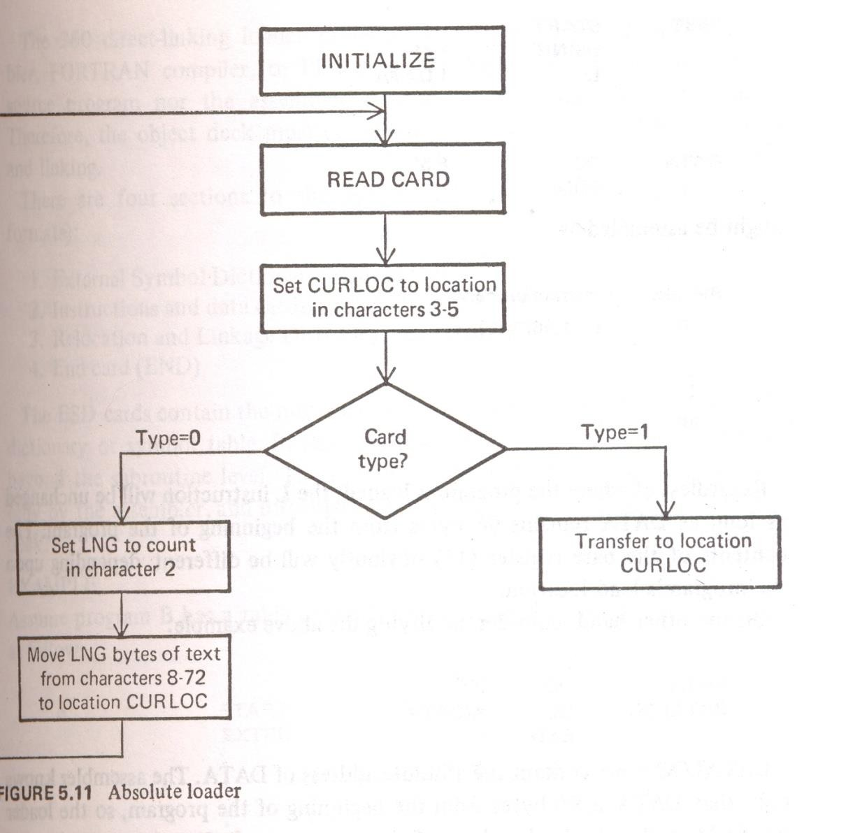
ALGORITHM
Object deck for this loader consists of a series of text cards terminated by a transfer card.
Read card.
Set CURLOC Current location) to location in characters 3-5.
If card type=1 transfer control to CURLOC and go to step 4 else if type=0 then :
a. Set LNG to count in character 2
b. Move LNG bytes of text from CURLOC.
c. Go to step 1.
4. Exit
characters 8-72 to location

Slide 46
DESIGN OF A DIRECT LINKING LOADER
Pass 1:Assigns addresses to all external symbols
Input object decks
Initial Program Load Address(IPLA)-supplied by the programmer or OS that
specifies the address to load the first segment
Program Load Address(PLA)-counter used to keep track of segments assigned location
Table-Global External Symbol Table (GEST)-store each external symbol and its corresponding assigned address
Copy of input to be later used by pass 2
Printed Listing, Load map-specifies each external symbol and its assigned value

Slide 47
Pass 2 perform actual loading, relocation and linking
Copy of object programs inputted to pass 1
IPLA
PLA
GEST
An array Local External Symbol Array-establishes correspondence between ESD ID numbers , used on ESD and RLD cards and corresponding external symbol’s absolute address value

Slide 48
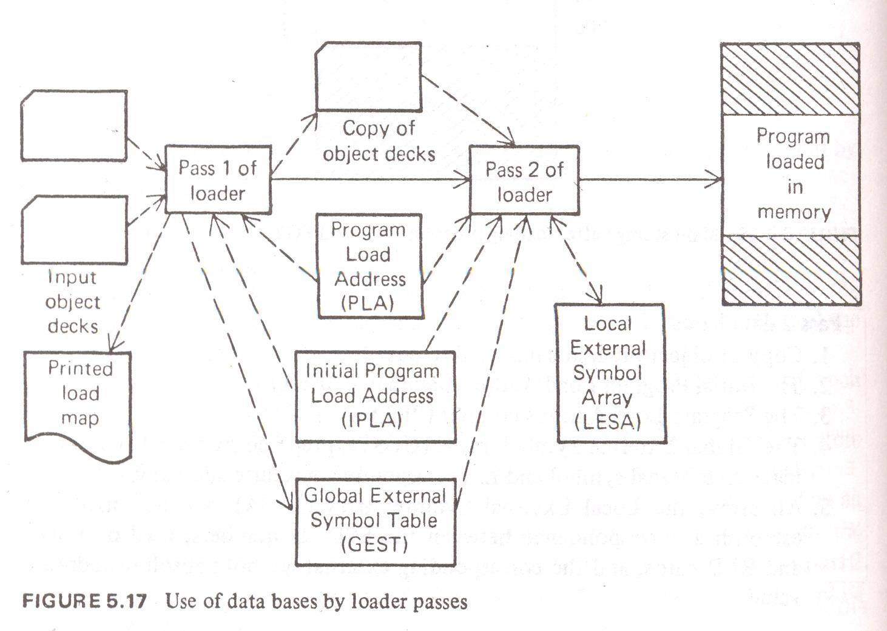
DATABASES USED BY DIRECT LINKING LOADER

Slide 49
USE OF DATA BASES BY LOADER PASSES
ESD CARD TXT CARD
Contents Columns Contents
Columns
1
Hexadecimal byte X’02
1 Hexadecimal byte X’02
2-4 Characters TXT
5 Blank
2-4
Characters ESD
5-14
Blank
15-16
ESD identifier
17-24
Name , padded with blanks
6-8
Relative address of first data byte (ADDR)
25
ESD type code
9-10
Blank
26-28
Relative address or blank (ADDR)
11-12
Byte Count=no. of bytes of information in 17-72
29
Blank
30-32 Length
₃₃₋D₇r.₂Harsha A Bhut_{B}e, _{la}U_{n}NI_{k}T III, SPOS, SPPU Syllabus Implementation FDP
13-16
Blank
17-72
From 1 to 56 data bytes
52
06/08/2021
73-80
Card Sequence Number
73-80
Card Sequence number

Slide 50
RLD CARD
END CARD
Columns
Contents
Columns
Contents
1
Hexadecimal byte X’02
1
Hexadecimal byte X’02
2-4
Characters RLD
5-18
Blank
2-4
Characters END
19-20
ID corresponding to a number assigned to
SD/ER on ESD card
5
Blank
6-8
Start of execution entry(ADDR), if other than beginning of program
21
Flag Byte
22-24
Relative address of first byte of address constant(ADDR)
9-72
Blank
25-72
Blank
73-80
Card Sequence Number
73-80
Card Sequence number

Slide 51
USE OF DATA BASES BY LOADER PASSES
GEST
Used to store external symbols defined by means of SD/LD entry on an ESD card
When encountered in pass 1 they are assigned absolute core address which is stored along with symbol
Local External Symbol Array (LESA)
GEST and ESD information of each individual deck is merged to produce
LESA

Slide 52
LINKING AND RELOCATION OF PROGRAMS
Linking
A program may wish to use library functions and other programs
The program should be combined with these library functions and programs
Linking is the function that performs this action
Relocation
Many programs may have the same origin specification
They have to be relocated if they are to be executed simultaneously
A program may have to be executed from a memory area that is different from the area for which it was compiled

Slide 53
Linking and relocation could be performed
Statically
Dynamically
Dynamic linking:
Only programs that are used during an execution are linked
Conserves memory
Dynamic relocation:
Facilitates compaction

Slide 54
SELF-RELOCATING PROGRAMS
A program P may have to be loaded for execution in different areas of memory
Relocation register in the CPU facilitates such execution
Alternatively, program P may be statically relocated to different memory areas
P may be relocated to many memory areas and resulting binary programs may be stored in library
Occupies too much library space and lacks flexibility
Static relocation may be performed before every execution of P causes delays
A self-relocating program avoids these problems

Slide 55
RELOCATING LOADERS
Reasons for Relocating Loaders
To avoid reassembling of segments/subroutines when a single subroutine is changed
Perform linking and allocation for the programmer
E.g.-IBM7094,IBM1130,GE635,UNIVAC 1108
BSS (Binary Symbolic Subroutine) Loader
Many procedure segments but 1 data segment
Each procedure is assembled separately ,this text , relocation information and inter segment references is passed to the loader

Slide 56
RELOCATING LOADERS
BSS (Binary Symbolic Subroutine) Loader
Text produced by assembler is prefixed by transfer vector
Transfer vector-consist of addresses containing names of subroutines referenced by source program
Additional Information provided to loader:
Length of the entire program
Length of the transfer vector
Loads segments after main program is loaded and place transfer instruction to the sub routine in each entry of the transfer vector
Scheme used with direct address instruction format

Slide 57
LINKERS
Inserts code to resolve program library references.
Combines object modules into an executable file.
Automatically called by the compiler.

Slide 58
TYPES OF LINKERS
Static Linker
After compilation, before execution.
Require more disk space and memory.
Faster and more portable.
Dynamic Linker
Resolve external references during execution.
Require less disk space and memory.
Execution time is more.

Slide 59
DYNAMIC LINKING
The loading and linking of external references are postponed until execution time.
The loader loads only the main program
If the main program should
execute a branch to an external address,
reference an external variable
The loader is called
Only then has the segment containing the external reference loaded.

Slide 60
REFERENCES
John J. Donovan,“System Programming”, McGraw Hill, ISBN 978-0—07-460482-3
Leland L. Beck, System Software:An Introduction To Systems Programming, 3RD Edition, Pearson, 1997

Slide 61

Queries if any

Slide 62
LAB ASSIGNMENT - IMPLEMENTATION
DLL WITH JNI

Slide 63
DYNAMIC LINK LIBRARY
A dynamic-link library (DLL) is a module that contains functions and data that can be
used by another module (application or DLL).
A DLL can define two kinds of functions: exported and internal.The exported functions are intended to be called by other modules, as well as from within the DLL where they are defined.
Significance:
DLL files are stored in a variety of program functions (sub-procedures) implementation process, when the program needs to call the function to load the DLL, and then get the address of the function, and finally make the call.The advantage of using DLL files is that the program does not need to load all the code at the beginning of the run, but only when a function is needed by the program to remove it from the DLL. In addition, using DLL files can also reduce the volume of your program.

Slide 64
ADVANTAGES OF DLL
Save more memory and reduce page switching
programs written in different programming languages can call the same DLL function just according to the function calling convention
Suitable for large-scale software development, make the development process independent, the coupling degree is small, facilitates the development and the test between different developer and the development organization.
Save disk space: When an application uses dynamic linking, multiple applications can share a single copy of the DLL on disk. In contrast, when an application uses a static-link library, each application links the library code to the executable image as a separate copy.

Slide 65
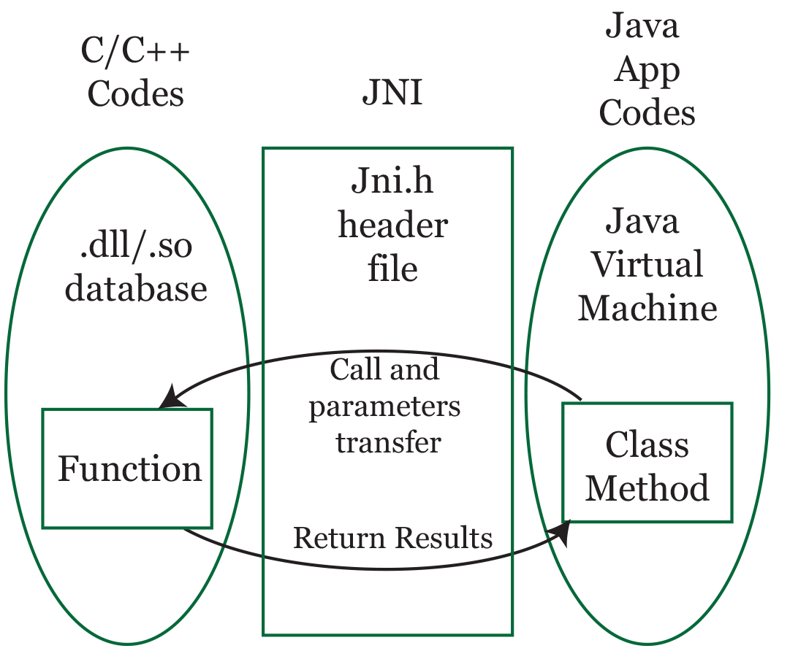
DLL IMPLEMENTATION WITH JNI
JAVA NATIVE INTERFACE
The Java Native Interface (JNI) enables runtime linking to dynamic native libraries.
The need to handle some hardware
Performance improvement for a very demanding process
An existing library that we want to reuse instead of rewriting it in Java

Slide 66
PROBLEM STATEMENT
Write a program to create a Dynamic Link Library for any mathematical operations and write an application program to test it. (Java Native Interface/Use VB/VC++)
Steps to create Dll with JNI
Write a Java Class that uses C Code- TestJNI.java
Create the C/C++ Header file - TestJNI.h
C Implementation - TestJNI.c
Run the Java Program

Slide 67
NATIVE METHOD
When making a native executable program, we can choose to use static or shared libs:
Static libs – all library binaries will be included as part of our executable during the linking process.Thus,
we won't need the libs anymore, but it'll increase the size of our executable file.
Shared libs – the final executable only has references to the libs, not the code itself. It requires that the environment in which we run our executable has access to all the files of the libs used by our program.
The latter is what makes sense for JNI as we can't mix bytecode and natively compiled code into the same binary file.
Therefore, our shared lib will keep the native code separately within its .so/.dll/.dylib file (depending on which Operating System we're using) instead of being part of our classes.

Slide 68
DISADVANTAGES
An application that uses a dynamic-link library is not self-contained, and it relies on a DLL module to exist, and if you use dynamic linking at load time, the program starts to discover that the DLL does not exist, and the system terminates the program and gives an error message.
While using runtime dynamic linking, the system does not terminate, but because the exported function in the DLL is not available, the program fails to load, and the speed is slower than the static link.When a module is updated, if the new module is incompatible with the old module, then the software that needs the module to run will die.

Slide 69

Case Study: Class loading in JAVA

Slide 70
SOME USEFUL LINKS
https://www6.software.ibm.com/developerworks/education/j-classloader/j-classloader- a4.pdf
https://javarevisited.blogspot.com/2012/12/how-classloader-works-in- java.html#axzz72eZFQDz8
https://www.baeldung.com/java-classloaders
http://www.cs.inf.ethz.ch/ssw/slides/SSW04_9_JVM_1x.pdf

